Slide 1


IEEE student hackathon on
Geospatial Technology for Sustainable Development (GTSD - 2023)
IEEE Geoscience and Remote Sensing Society (GRSS)
Bangalore Section
Team Name: PyGeoAI
Topic: Forest Fire Monitoring (SDG#13)
Team member 1: Pyare Lal, Affiliation: PhD, IISERB
Team member 2: Aakash Singh Bais, Affiliation: JRF, IISERB
Data Science and Engineering Department

Slide 2
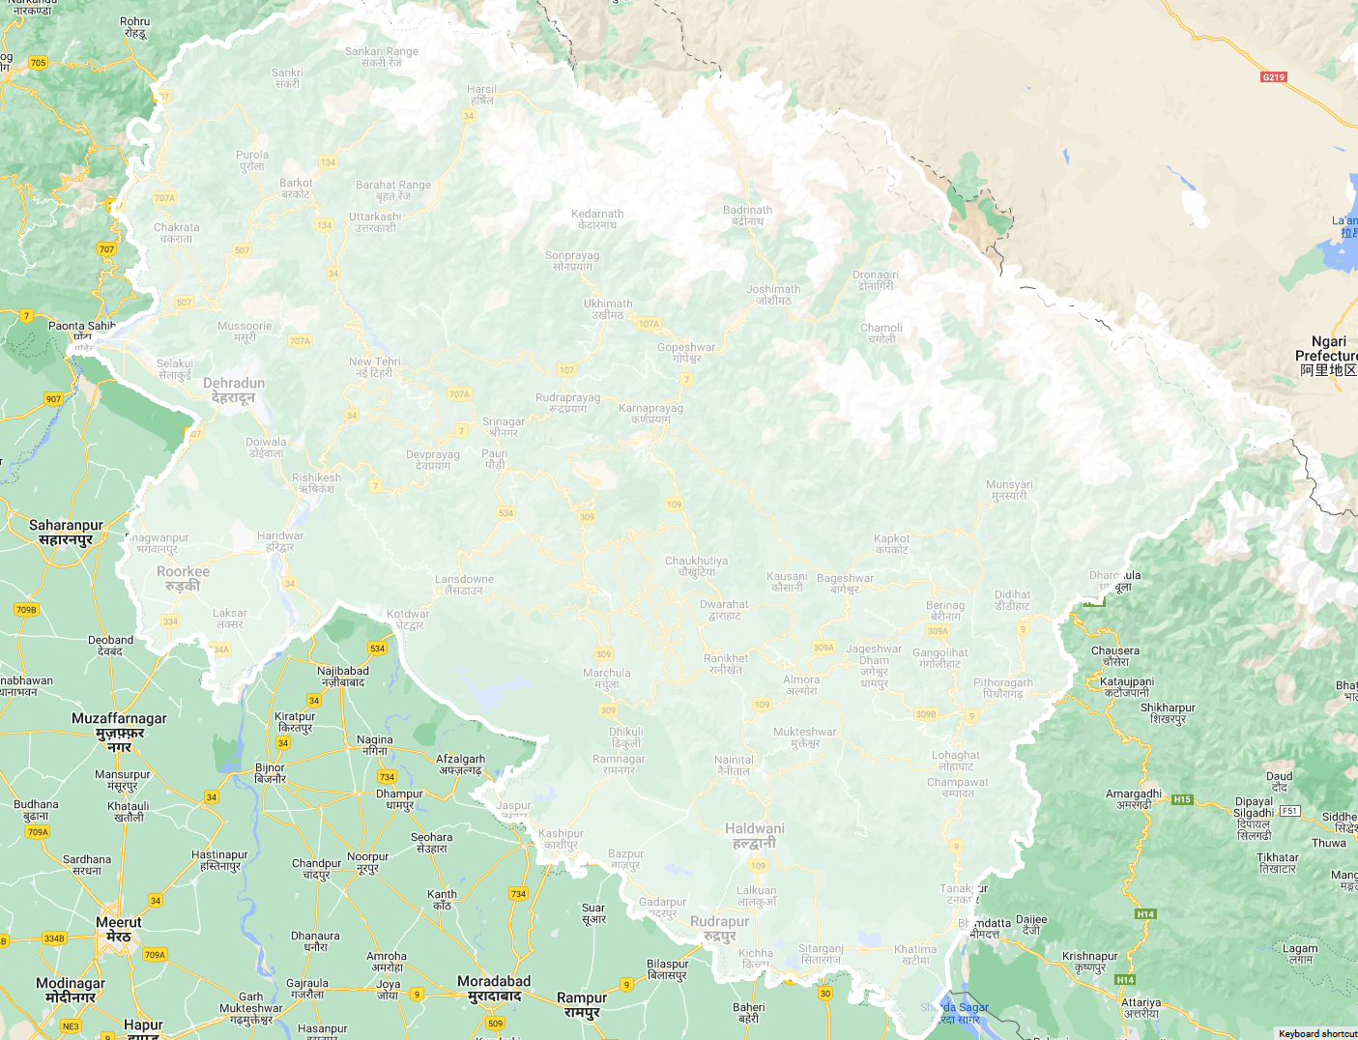
Study Area

Slide 3
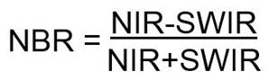
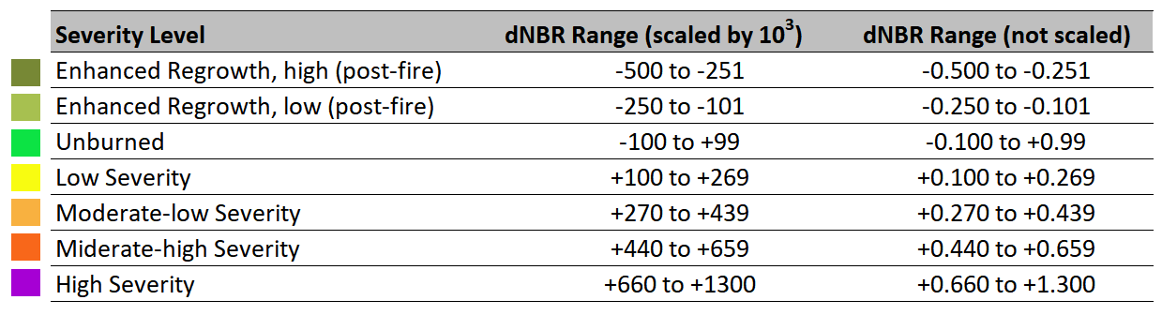
Post Fire Monitoring

Slide 4
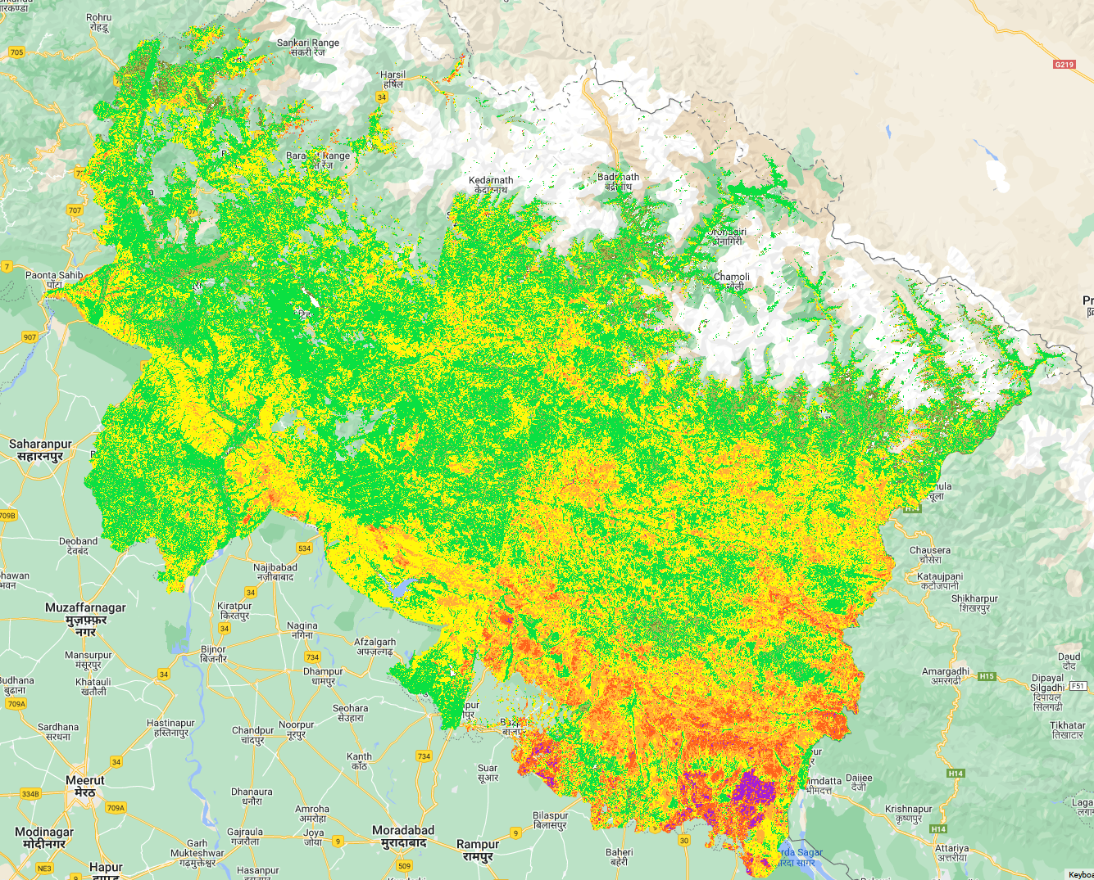
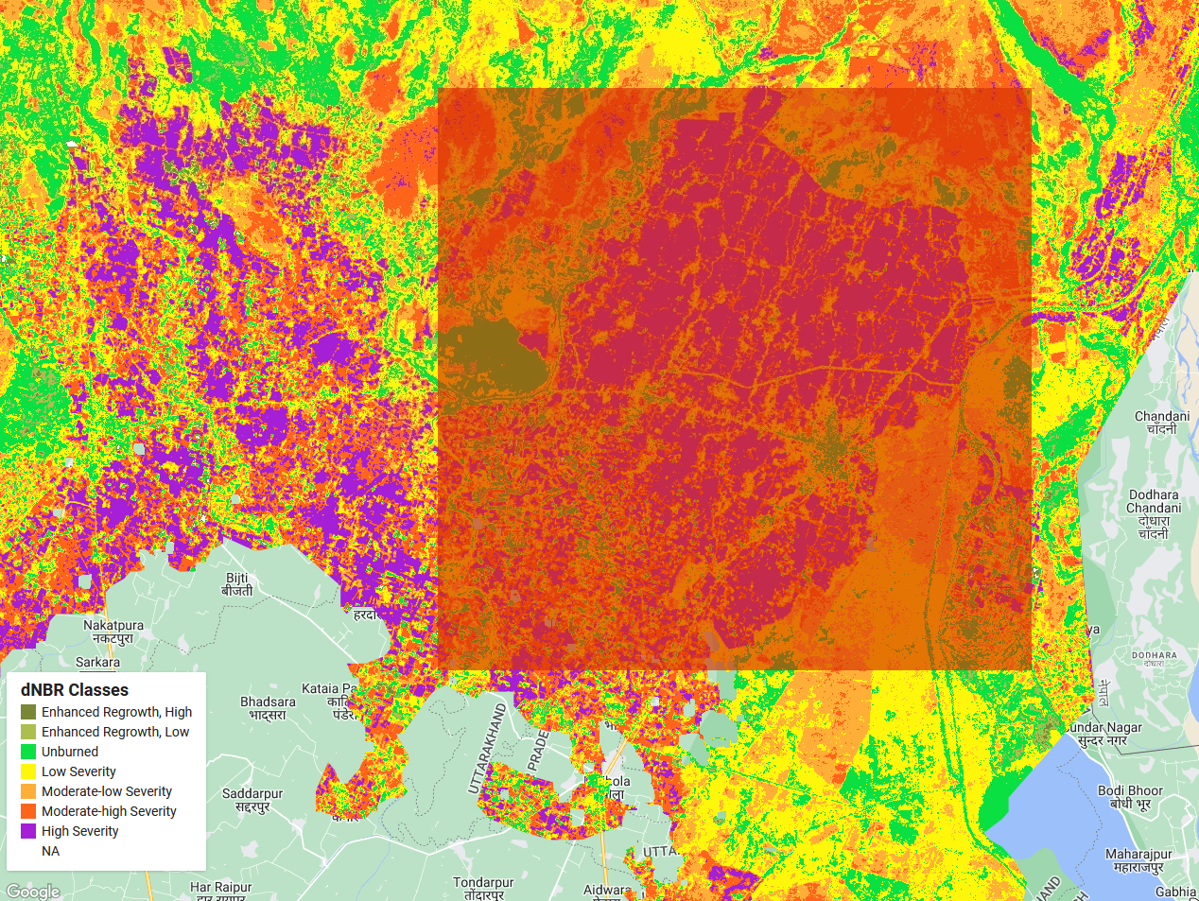
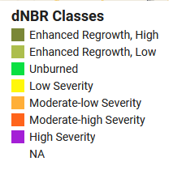
dNBR

Slide 5
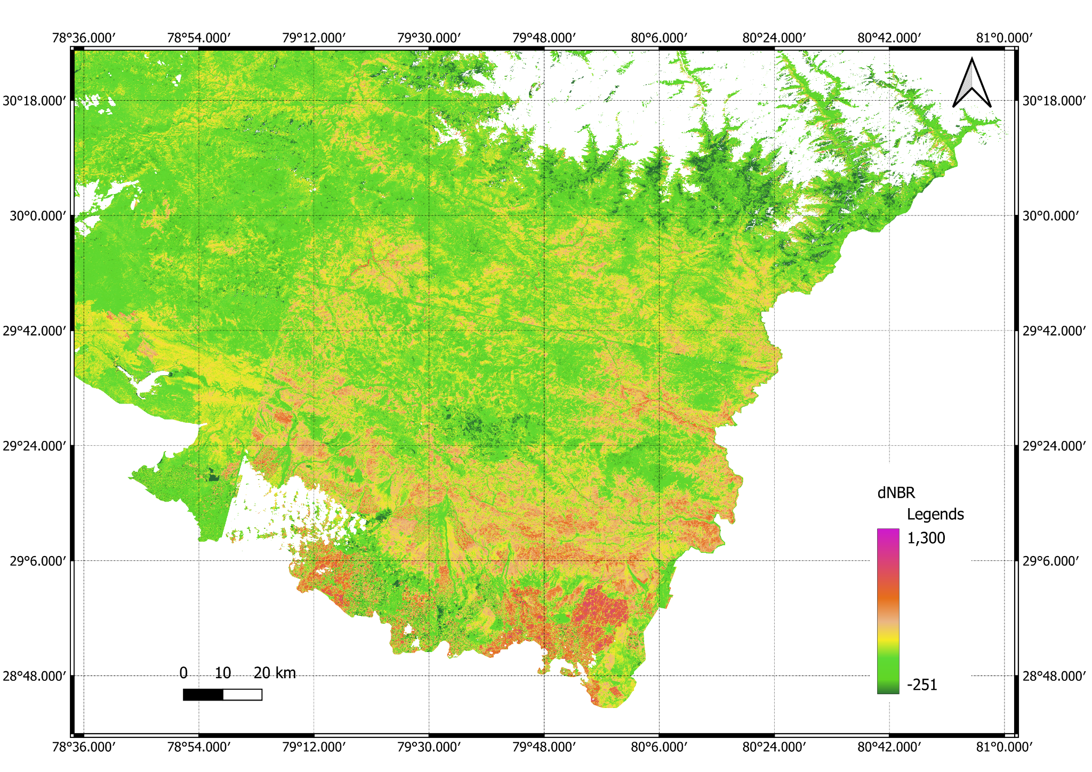

Slide 6
Burned Area Stats
system:index | Class | Hectares | Pixels | Percentage
0 | NA | 0 | 0 | 0
1 | High Severity | 14003.37 | 155593 | 28.39
2 | Moderate-high Severity | 10395.99 | 115511 | 21.08
3 | Moderate-low Severity | 9113.58 | 101262 | 18.48
4 | Low Severity | 10289.43 | 114327 | 20.86
5 | Unburned | 4787.1 | 53190 | 9.71
6 | Enhanced Regrowth, Low | 472.77 | 5253 | 0.96
7 | Enhanced Regrowth, High | 259.29 | 2881 | 0.53

Slide 7
THANK YOU!

